Slide 1
The Prophet said, "There was a merchant who used to lend the people, and whenever his debtor was in straitened circumstances, he would say to his employees, 'Forgive him so that Allah may forgive us.' So, Allah forgave him."

Slide 2
Lecture 10
JavaScript

Slide 3
Previous Lecture
Understanding DOM
DOM API
Adding, Removing, Replacing Nodes

Slide 4
Today’s Lecture
Getting information from Events
Node Types

Slide 5
Getting information from Events
myTag.onclick = function(evt){
//evt contains all information of this event }

Slide 6
Node Types
nodeType property describes the basic core type of a node.
Element node > 1
Attribute node > 2
Text node > 3
Comment node > 8

Slide 7
Node Name
nodeName returns the name of the selected element.
<span id=“myElement”></span>
<script>
myElement.nodeName //SPAN
</script>

Slide 8
firstChild, lastChild
<script>
myElement.firstElementChild //<b>This is bold</b> myElement.lastChild
// <section>This is a section</section>
myElement.childNodes[1]
//<p>This is a paragraph</p>
</script>
<div id=“myElement”>
<b>This is bold</b> <p>This is a paragraph</p> <section>This is a section</section>
</div>

Slide 9
Objects
Object is simple a bundle of properties and functions.
Can hold any number of properties and functions.
//Define an Object
var obj = {};
var obj = new Object();(Advanced)

Slide 10
Objects
Define an object with properties and functions.
var obj = {
name : value
}
var person = { name : ’Khurram’,
city : ’Karachi’,
classes:[‘web’, ‘AI’],
playFootball : function(){ }
};
person. playFootball ();
person.name
Person.classes.forEach(function(item){ //web
})

Slide 11
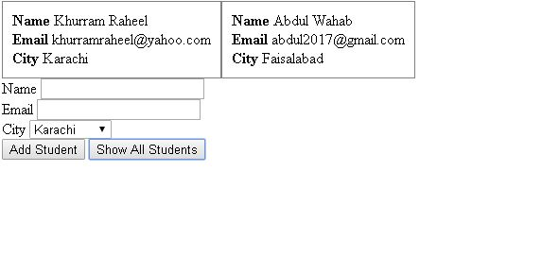
Today’s Assignment

